Slide 1

B.Tech Project Final External Evaluation Smart Tank Management System
Presented by :-
Rohit Kumar, 2019006520
Shubham , 2019004953
Under the Supervision of:-
( Ms. Saptadeepa Kalita)
Sharda University, Gr. Noida
DEPARTMENT OF COMPUTER SCIENCE & ENGINEERING
SCHOOL OF ENGINEERING AND TECHNOLOGY
September, 2022
1

Slide 2
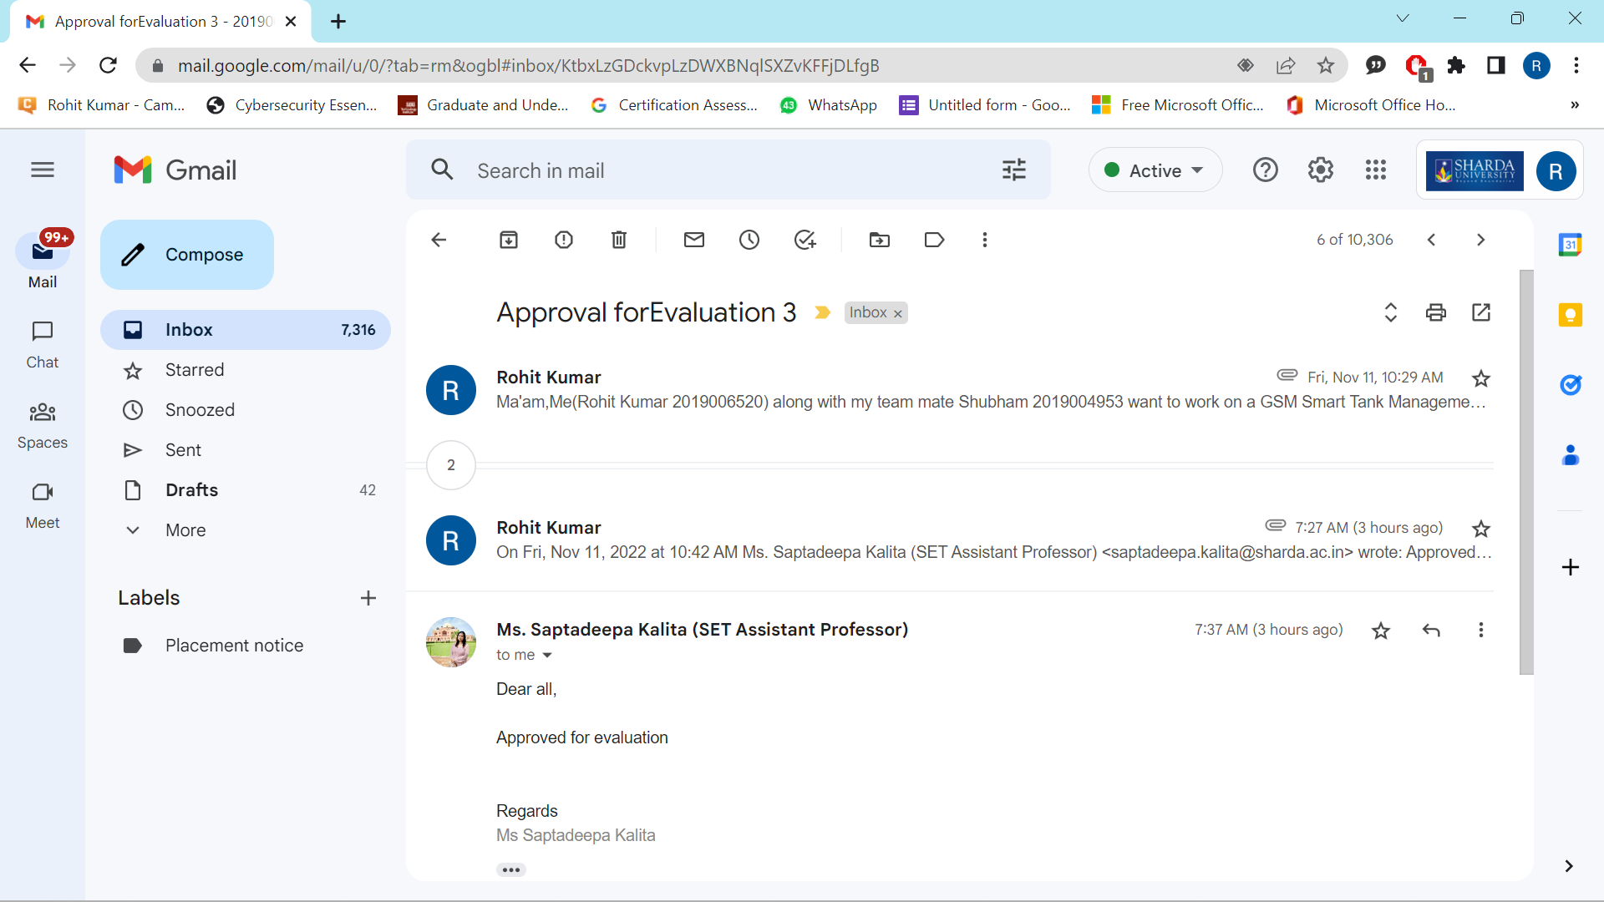
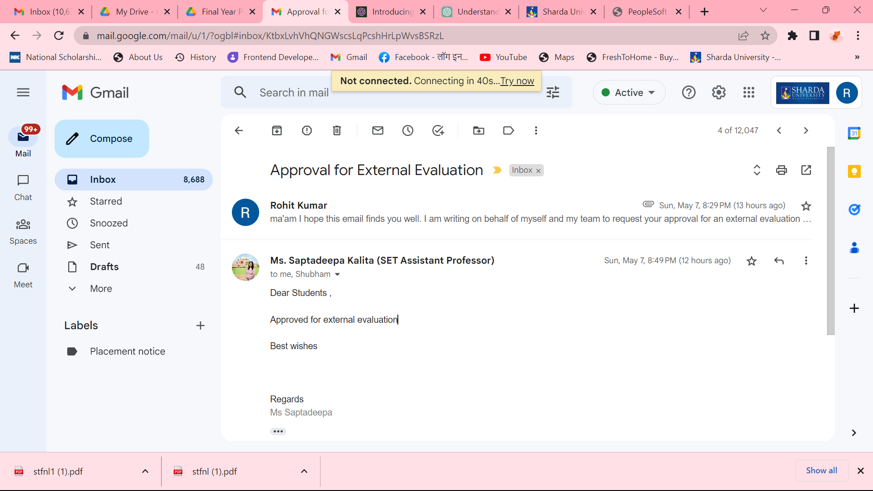
Approval from guide for External Evaluation

Slide 3

OUTLINE
Introduction
Literature Survey
Motivation
Project Planning and Management
Problem statement
Methodologies
Features
Hardware/Software Used
Future Scope
References

Slide 4

Introduction to the Project
In this project we are presenting the development of water level monitoring system with an integration of IoT technology to alert the person-in-charge through a Web Application notification.
This project's functioning is straightforward and easy to comprehend. There are three essential prerequisites in our project "smart tank management“

Slide 5
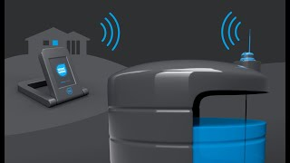
Introduction to the Project
In our project we have, level monitoring sensor for detecting the level of water in water tank.
we have also used Humidity sensor which automatically detect the Humidity of water Tank.
The Proposed system also aims to introduce IoT sensor which sense the temperature of the water in the water tank.

Slide 6
Literature Survey
S.NO | Paper details | Hardware Used | Result
1. | Reddy, P. J. P., Viswanadh, G., & Singh, S. K. (2021, April). IOT based Smart Water Pump Switch. In 2021 2nd International Conference on Intelligent Engineering and Management (ICIEM) (pp. 534-538). IEEE. | IC555 Diodes Regulator Push Button Connecting wire Crystal Oscillator Switches | This approach saves the water and electricity. Which is essential for our daily life. It will help us for detecting water leakage in our house. We can also use this for fuel detector in any tank.
2. | Sunmonu, R., Aduramo, S., Abdulai, O. S., & Agboola, E. A. (2017). Development of an Ultrasonic Sensor Based Water Level Indicator With Pump Switching Technique. J. Electr. Eng. | Echo LCD Ultrasonic distance Sensor Programmable microprocessor IC Socket Crystal Oscillator Arduino Uno | On order to achieve high level of our developed module the acceptable module have error margin of 0.17% by maximum is evaluated. More over performance evaluation of the system was set at 99.83% where's the minimum was 0.17% of the holding capacity of the tank.
3. | Zaher, A. A., Al-Refaei, A., Al-Enezi, A., & Al-Azemi, T. (2021, November). Smart Domestic Water Management System. In 2021 IEEE International Conference on Internet of Things and Intelligence Systems (IoTaIS) (pp. 241-246). IEEE. | Arduino Uno Microcontroller Wi-Fi module Ultrasonic sensor Ph sensor TDS sensor Water flow sensor Temperature sensor Cooler Relay | The main feature of this paper is it comprises intelligent decision-making based on exact real-time field. Smart domestic water management, which involves monitoring the water level. So that they can control their water pump through their mobile.

Slide 7
Literature Survey
S.No | Paper details | Hardware Used | Result
4. | Ratnadewi, R., Nurdiyanto, H., Najmurrokhman, A., Prabowo, C., Idmayanti, R., Eteruddin, H., ... & Rahim, R. (2018, August). Control and Notification Automatic Water Pump with Arduino and SMS Gateway. In IOP Conference Series: Materials Science and Engineering (Vol. 407, No. 1, p. 012160). IOP Publishing. | Arduino UNO LCD Relay Buzzer GSM SIM900a | he experiment results of GSM SIM900A module is performed by sending a short message by the owner #POMPA ON@ water pump will be on/off.
5. | Lohani, R. K. DESIGN & DEVELOPMENT OF WATER MANAGEMENT SYSTEM. | Temperature sensor Humidity sensor 600-W high-efficiency power supply CC3200 Single chip with integrated microcontroller 5. Camera | By monitoring the efficiency of the soil, temperature and humidity, rain fall, fertilizer efficiency, monitoring water tank storage capacity, and also detecting theft in agricultural regions, this research expects a rise in output at a cheap cost.

Slide 8
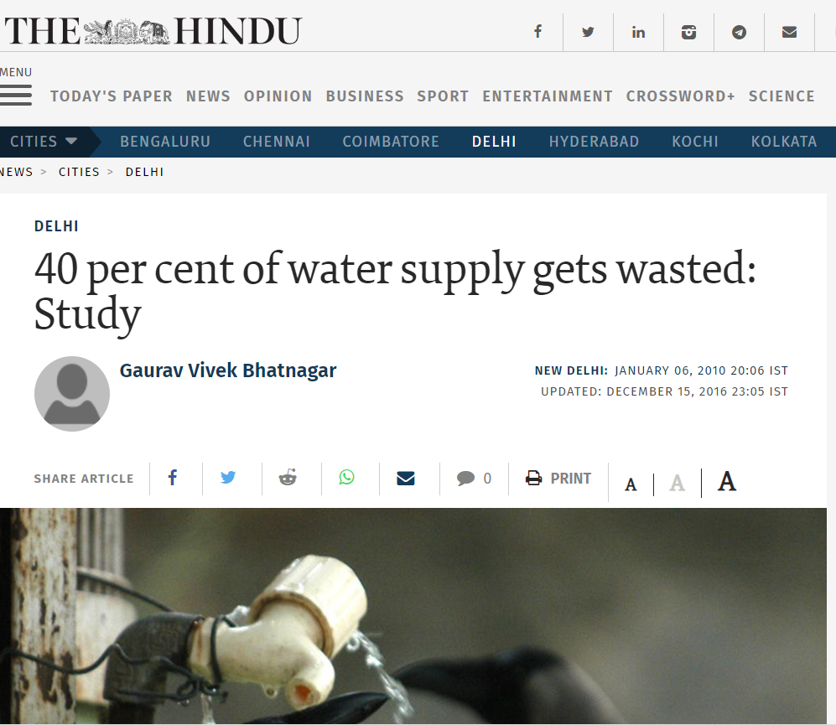
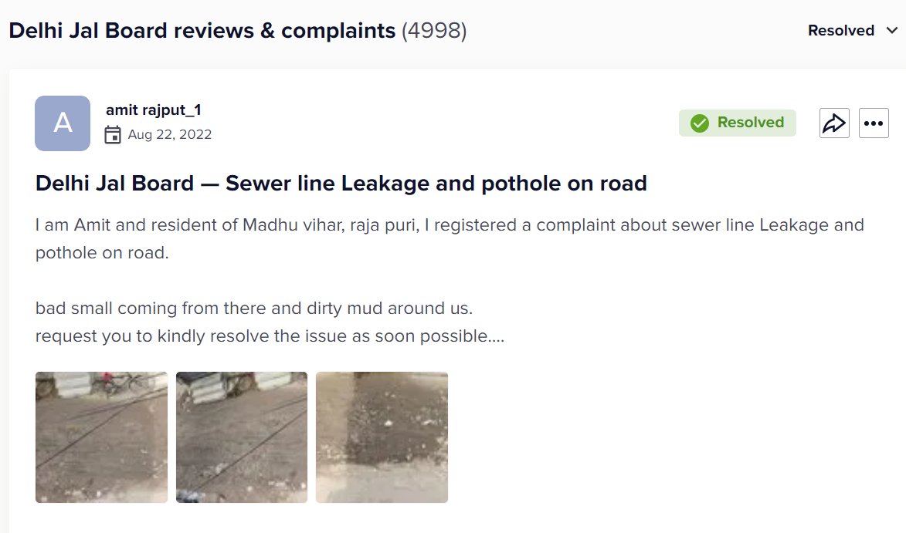
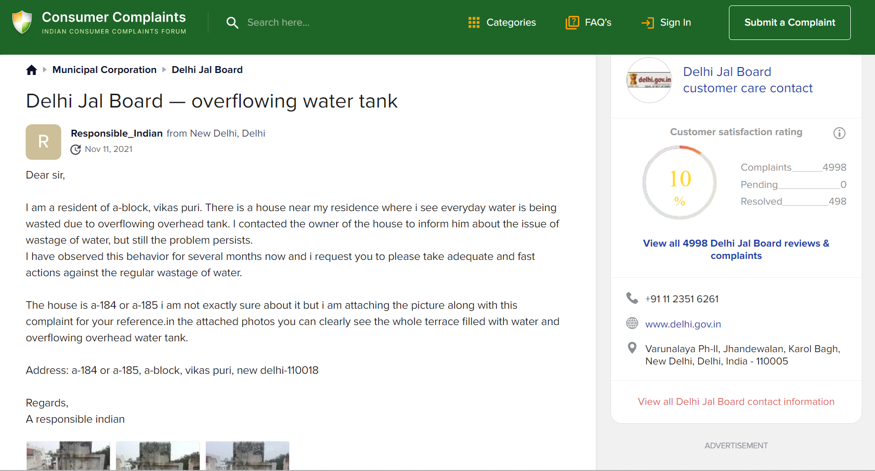
MOTIVATION
We observe how much water people waste in urban area when they fail to turn off their motors and waste millions of litres everyday.
We surveyed and found that at least 20 to 30 % water is wasted by overflow of water tank in Delhi.
According to a Survey, Delhi Jal Board supply 2034 million litres per day. It means 400 to 600 million litres will wasted through over flow of water tank.

Slide 9
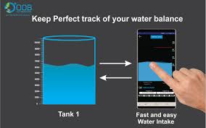
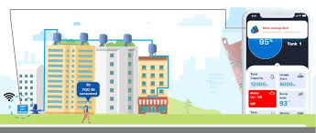
PROJECT MANAGEMENT PLANNING
Cost Analysis
We identify all the cost and benefits of carrying out the project and operating the delivered application,
Expressing these cost and benefits in common units
Setup cost for putting the project into use , it include any hardware and ancillary equipment

Slide 10
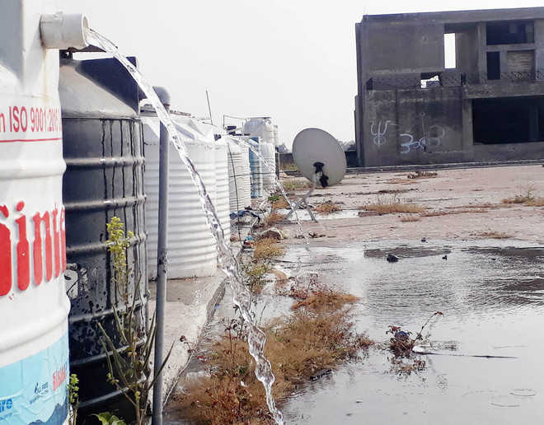
PROBLEM STATEMENT
The capacity of the existing water supply infrastructure to meet forecast water supply is related to the water level supply problems identified within the region.
Nowadays, owing to our hectic schedules, we frequently overlook little details such as turning off the water pump, and as a result, we are experiencing issues such as water and energy shortages.

Slide 11
Methodologies
* Smart level detector device sends signal to router through ESP32 about the level of water in water tank.
*Router is the access point between ESP32 web server and the client.
* The Second Controlled motor device uses the ESP32 Connected with a motor get off/on automatically. The motor and ESP32 are Configured with router to receive the signal and perform the specified operation to make motor on/off.

Slide 12
Methodologies
The Web App will be able to monitor the water level as well as controlling the motor by sending signal.
ESP32 will scan all the nearby networks and connect to the matching ssid and password and all the devices which have same ssid and password will able to make connections.
The signal will be in the form of text sent from the App to the IoT device to controlled motor device. which is automatically turn on/off the motor using ESP32.

Slide 13
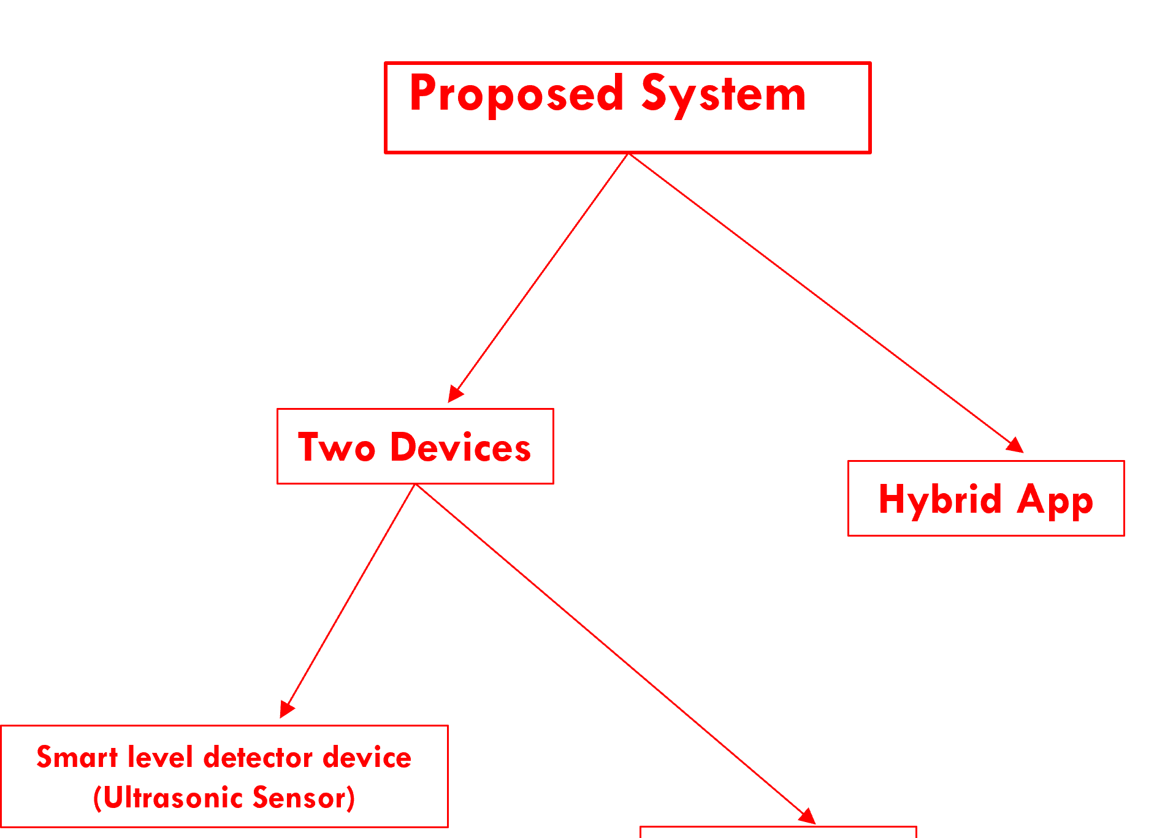
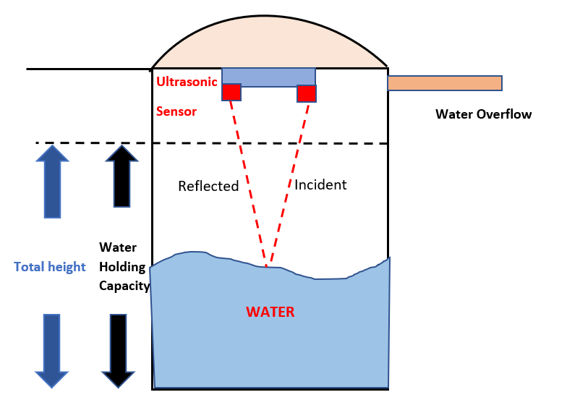
Methodologies
Web application
ESP32
Block diagram of Proposed system

Slide 14
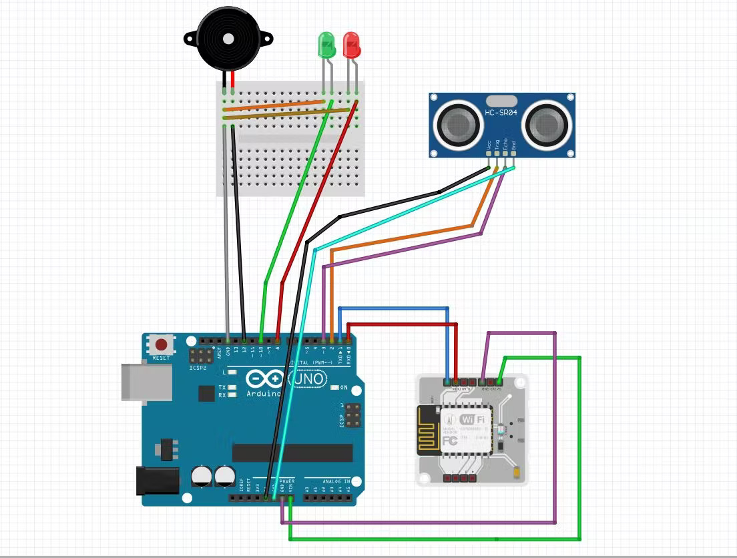
Methodologies
Circuit diagram of proposed system

Slide 15
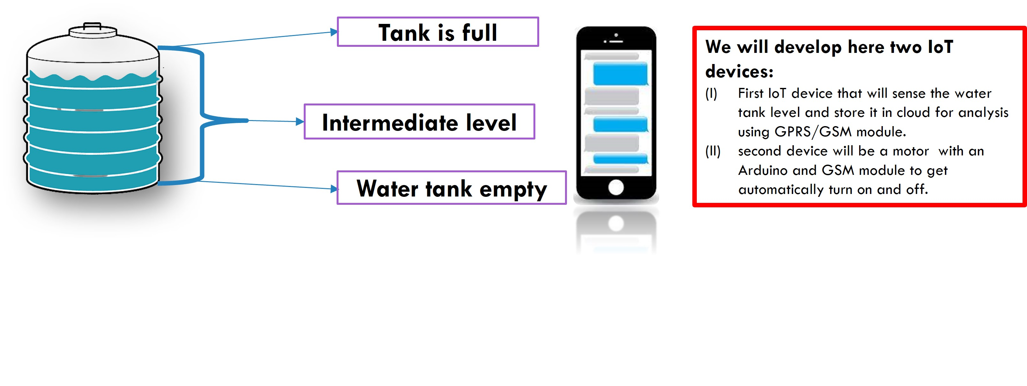
Features of STMS
Water management: User may monitor the water level using their cell phones. The motor will operate automatically as a result of this technology. If the water level goes down, the motor automatically turns on, and if the water level is high, the motor will shut down.

Slide 16
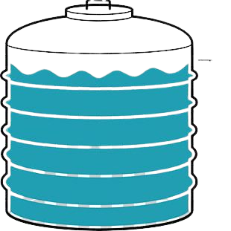



Features of STMS
Water monitoring: Water monitoring entails determining the level of water. Basically this features assist the user to know that what is the level of water in real time. Through our web app we will alert him about the level of water inside the tank.
Weekly Usage 15000L
Over usage of water.

Slide 17
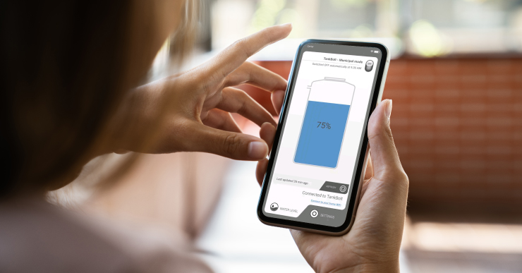
Features of STMS
Remote controlling: In our proposed system, this is one of the highlighting features. It allows the user to control the water pump. User has to only switch on the water pump, when water level touches the highest level of the tank then motor will be automatically turned off.

Slide 18

Features of STMS
Humidity monitoring: This feature assist the user to monitor the humidity of water.it would raise an alert to the user if the contamination is raised high above the fixed threshold. So that the proper cleanliness and accurate level is ensured.

Slide 19
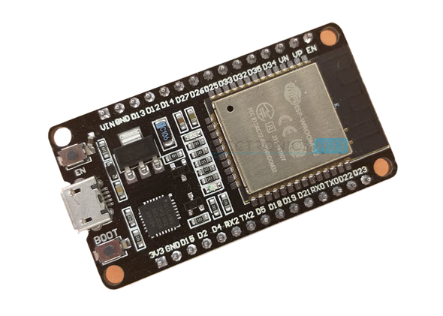
Hardware Used{1}
Esp32: It is a low cost system on chip(SoC) microcontroller from Espressif system, the developers of the famous ESP8266 SoC. It is a successor to ESP8266 SoC and comes in the both single and double core variation. It is integrated with Wi-Fi and Bluetooth.

Slide 20
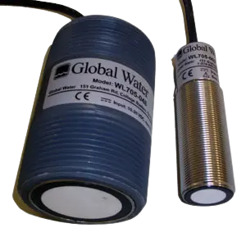
Hardware Used{2}
Ultrasonic Sensor: Ultrasonic water level sensor installation is simple and requires no programming or calibration. No maintenance is required for the ultrasonic water level sensors. The WL705 Ultrasonic Level Sensors are rugged, reliable and completely weatherproof. The ultrasonic water level sensors are ideal for sewer or wastewater applications. The ultrasonic water level sensors are easy to mount, come with a 6 ft standard cable and complete instructions. The ultrasonic water level sensors are easy to interface to all PLC's, SCADA and telemetry systems with its simple 3-wire 4-20 mA output. The WL705 Ultrasonic Water Level Sensor is compatible and provided optionally with the Global Water FC220 Open Channel Flow Monitor and the PC320 Process Controller (for water level control).
WL705 Ultrasonic Water Level Sensor

Slide 21
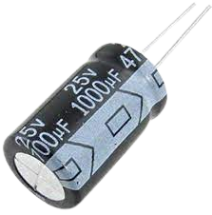
Hardware Used{3}
Capacitor(1000 uf): It has a ability or “capacity” to store the energy in the form of an electrical charge producing a potential difference (Static Voltage) across its plates, much like a small rechargeable battery. It has a insulating layer between a capacitors plates commonly called Dielectric. We used it in direct current, a capacitor charges up to its supply voltage but blocks the flow of current through it because the dielectric of a capacitor is non-conductive and basically an insulator.

Slide 22
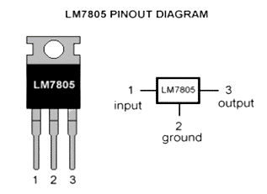
Hardware Used{4}
IC7805 : Voltage sources in a circuit may have fluctuations resulting in not providing fixed voltage outputs. A voltage regulator IC maintains the output voltage at a constant value. 7805 Voltage Regulator, a member of 78xx series of fixed linear voltage regulators used to maintain such fluctuations, is a popular voltage regulator integrated circuit (IC). The xx in 78xx indicates the output voltage it provides. 7805 IC provides +5 volts regulated power supply with provisions to add a heat sink.

Slide 23
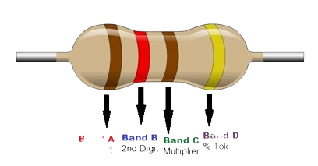
Hardware Used{5}
Resistor : A resistor is a passive electrical component with the primary function to limit the flow of electric current.It absorbs electrical energy, reduces the voltage, impedes the flow of current, and releases it as heat. In today's electronics world, heat dissipation is typically a fraction of a watt.

Slide 24
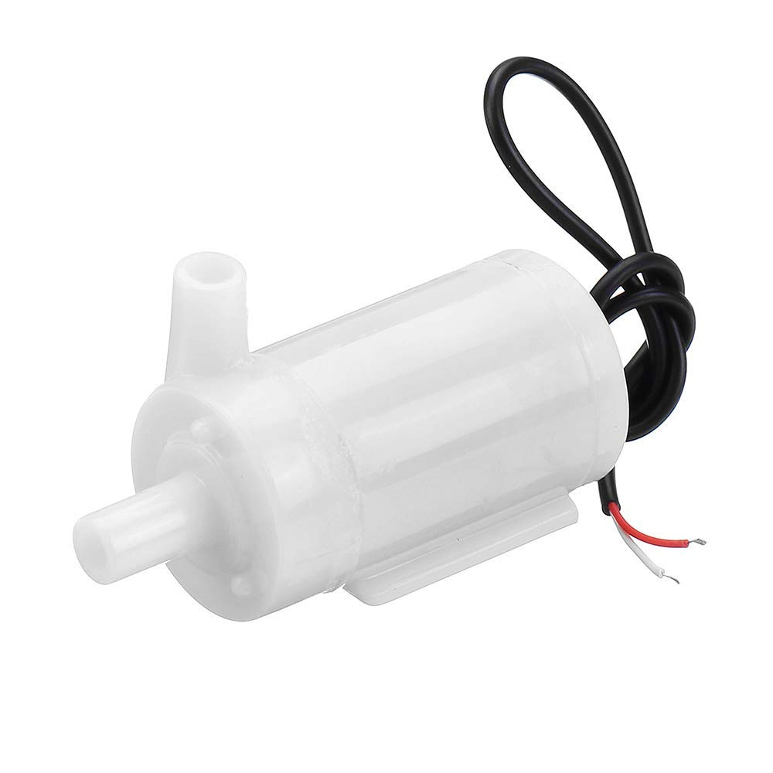
Hardware Used{6}
Water pump: The DC 3-6 V Mini Micro Submersible Water Pump is a low cost, small size Submersible Pump Motor. It operates from a 2.5 ~ 6V power supply. It can take up to 120 liters per hour with a very low current consumption of 220mA. Just connect the tube pipe to the motor outlet, submerge it in water, and power it.

Slide 25
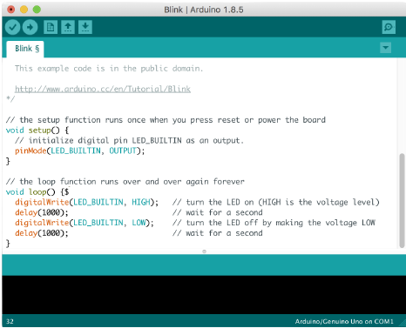

Software Used{1}
Arduino IDE: Power up the Arduino by connecting USB cable to the computer, We will see the LED label on light up. Select the required part in software and upload the code to the Arduino, With respect to the code the output can be seen an serial monitor.

Slide 26
Future scope
pH monitoring: In the future we will add a feature that will determine the pH of water and ensure the user about the quality of water.

Slide 27
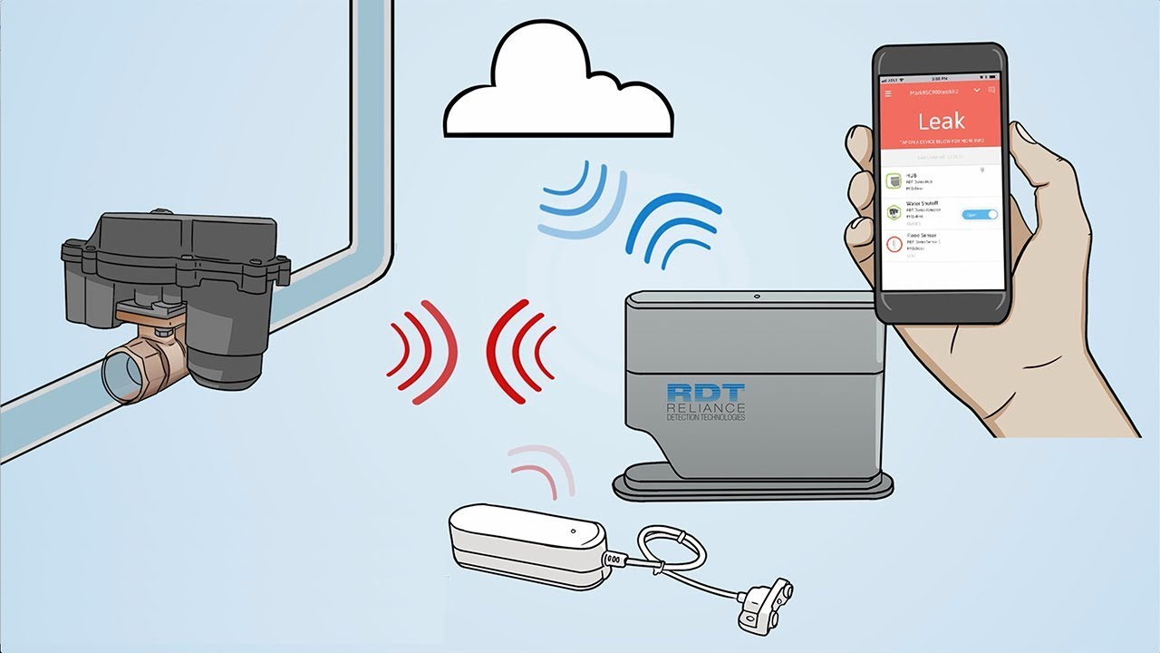
Future scope
Leakage detection: This features is applied for only industrial area. This is not feasible for residential area. With the help of this feature we can detect the leakage of water and chemicals. Through this feature we can save water as well as any liquid.

Slide 28
Reference
Ratnadewi, R., Nurdiyanto, H., Najmurrokhman, A., Prabowo, C., Idmayanti, R., Eteruddin, H., ... & Rahim, R. (2018, August). Control and Notification Automatic Water Pump with Arduino and SMS Gateway. In IOP Conference Series: Materials Science and Engineering (Vol. 407, No. 1, p. 012160). IOP Publishing.
Zaher, A. A., Al-Refaei, A., Al-Enezi, A., & Al-Azemi, T. (2021, November). Smart Domestic Water Management System. In 2021 IEEE International Conference on Internet of Things and Intelligence Systems (IoTaIS) (pp. 241-246). IEEE.
Sunmonu, R., Aduramo, S., Abdulai, O. S., & Agboola, E. A. (2017). Development of an Ultrasonic Sensor Based Water Level Indicator With Pump Switching Technique. J. Electr. Eng.
Reddy, P. J. P., Viswanadh, G., & Singh, S. K. (2021, April). IOT based Smart Water Pump Switch. In 2021 2nd International Conference on Intelligent Engineering and Management (ICIEM) (pp. 534-538). IEEE.
Lohani, R. K. DESIGN & DEVELOPMENT OF WATER MANAGEMENT SYSTEM.

Slide 29

THANK YOU

